Slide 1
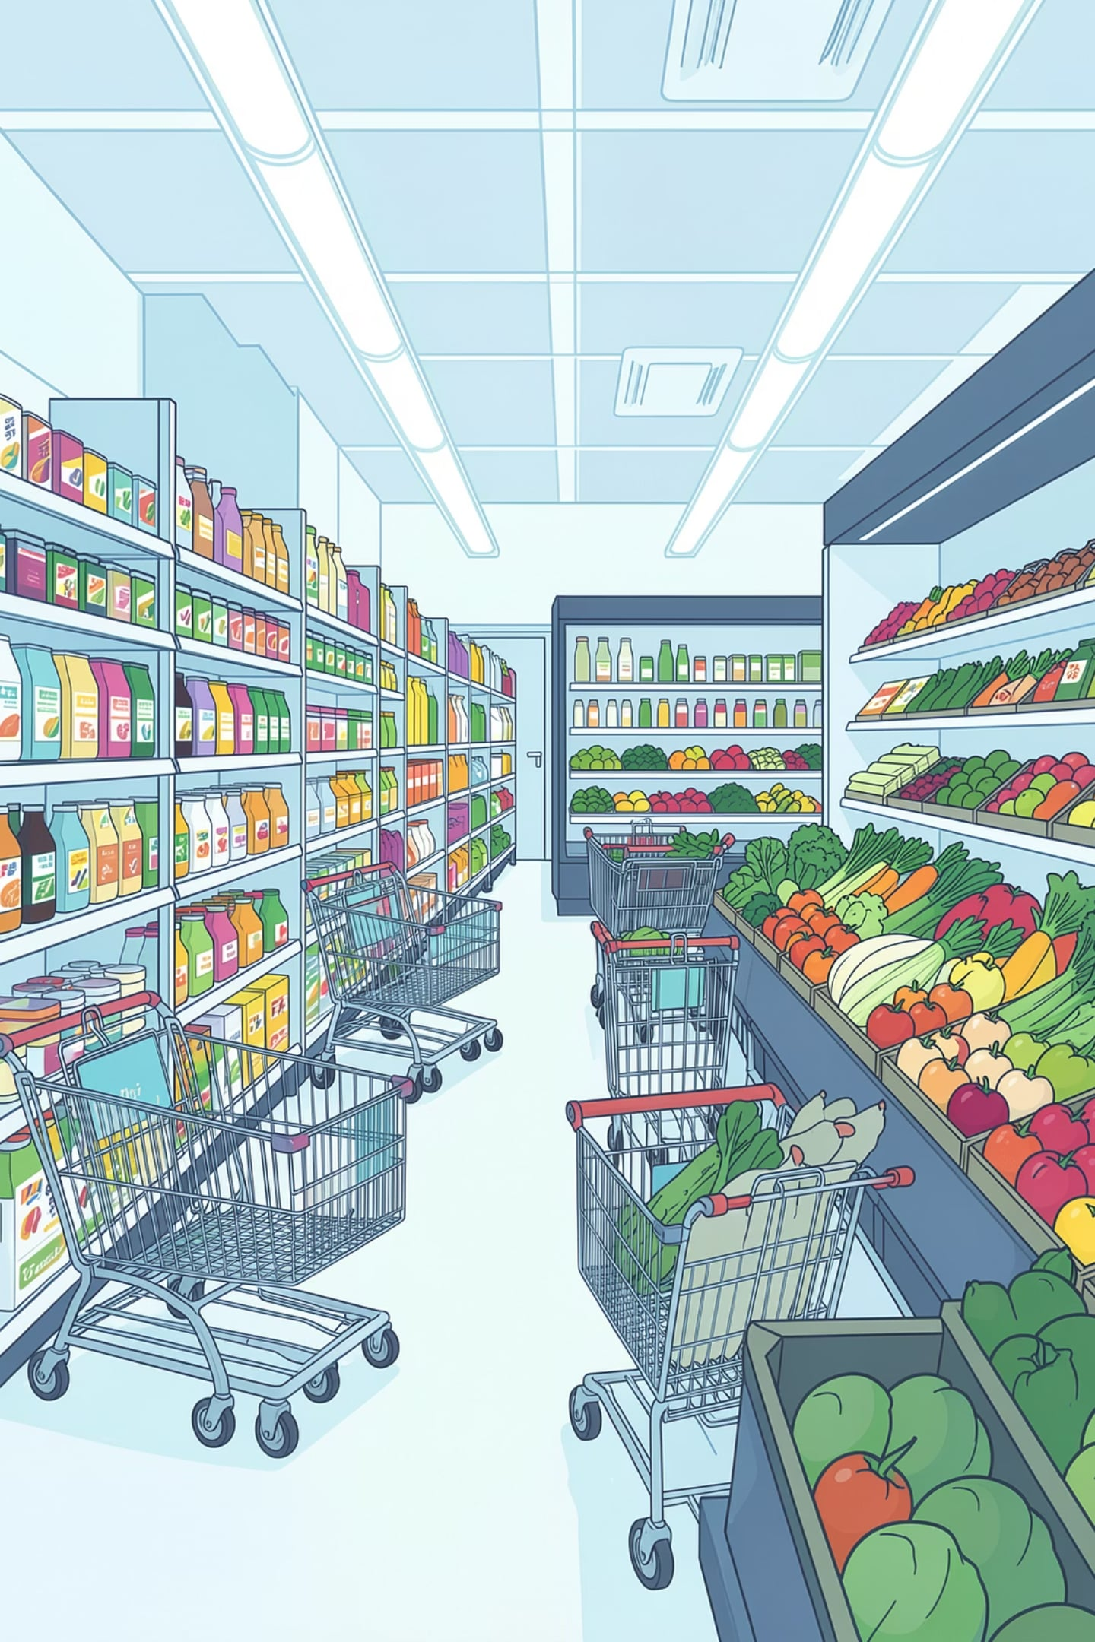

MINI PROJECT PRESENTATION
Grocery Inventory Management System
A console-based C application for managing grocery stock with product tracking, search, and inventory operations.
Raj Sharma · B.Tech (CSE-AI)

Slide 2
Problem Statement and Solution
Small grocery stores often struggle to keep stock accurate when everything is tracked by hand.
Manual Register Management
Digital Inventory Management
Human errors in record-keeping
Inaccurate stock information
Time-consuming manual inventory updates
Difficulty searching for products quickly
Organized system for stock tracking
Improved accuracy and reliability
Faster inventory updates
Quick product search and retrieval

Slide 3







OBJECTIVES
What This System Achieves
Add Products
Display Products
Register new items with ID, name, quantity, and price.
View the full inventory in a formatted table.
Search Products
Update Stock
Locate any item quickly by product ID or name.
Modify quantity or price of existing products.
Delete Products
Menu-Driven Interface
Remove discontinued items from the inventory.
Simple, intuitive console menu for all operations.

Slide 4








FEATURES
Core Features at a Glance
Product ID
Product Name
Unique identifier for each product
Descriptive name for easy recognition
Quantity
Price
Real-time stock count tracking
Per-unit cost stored per product
Search
Update Stock
Find products by ID or name
Edit quantity or price instantly
Delete Product
Display Inventory
Remove items from inventory
View all products in table format

Slide 5

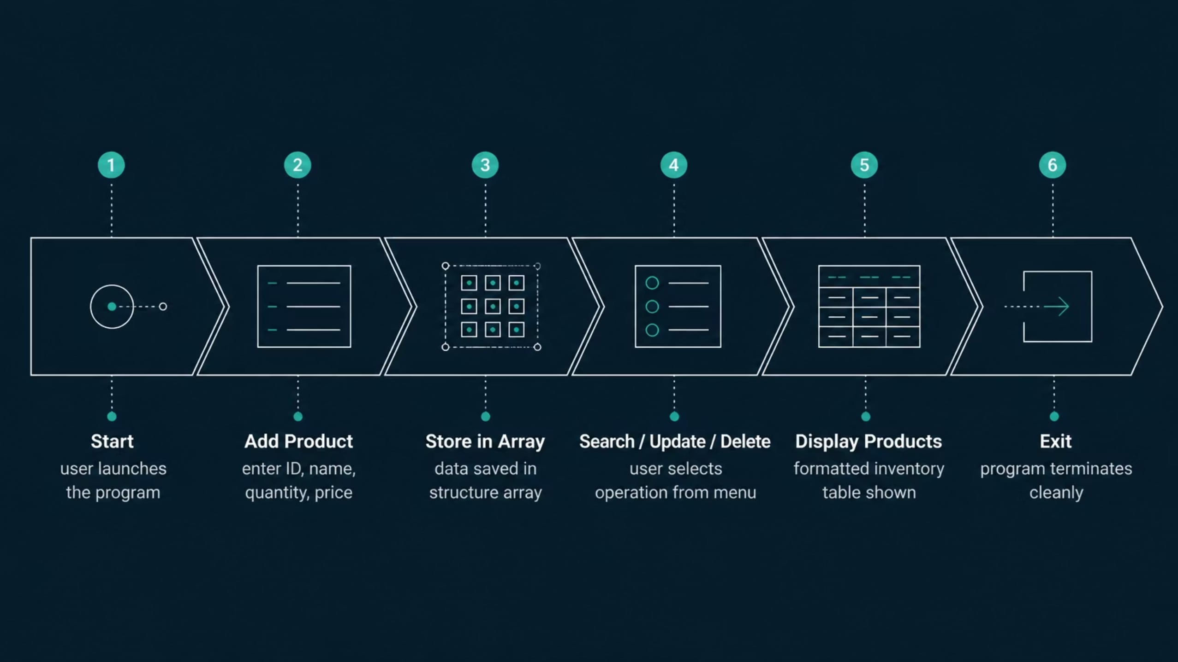
SYSTEM WORKFLOW
How the System Flows

Slide 6
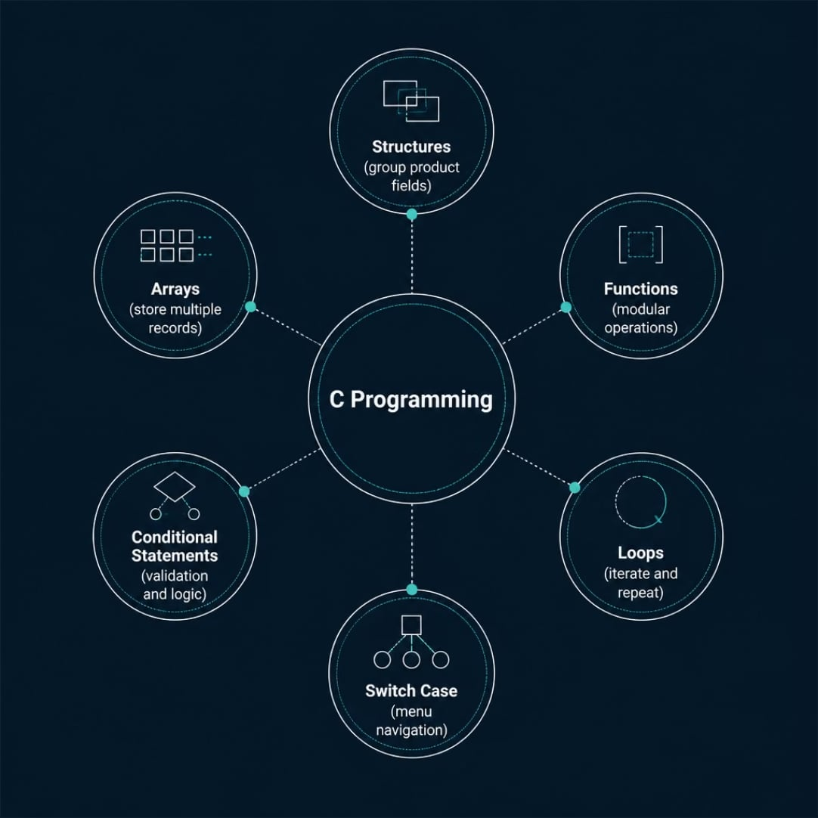

C PROGRAMMING CONCEPTS
Core Concepts Applied
This project demonstrates six fundamental C programming constructs working together to build a functional, menu-driven inventory system.
Structures
Arrays
Functions
Loops
Bundles product ID, name, quantity, and price into a single record type.
Stores multiple product records in contiguous memory for fast access.
Modularizes add, search, update, delete, and display operations.
Iterates through arrays for display, search, and input validation.
Switch Case
Conditional Statements
Drives the menu-driven interface with clean option branching.
Handles validation, stock checks, and decision logic throughout.

Slide 7

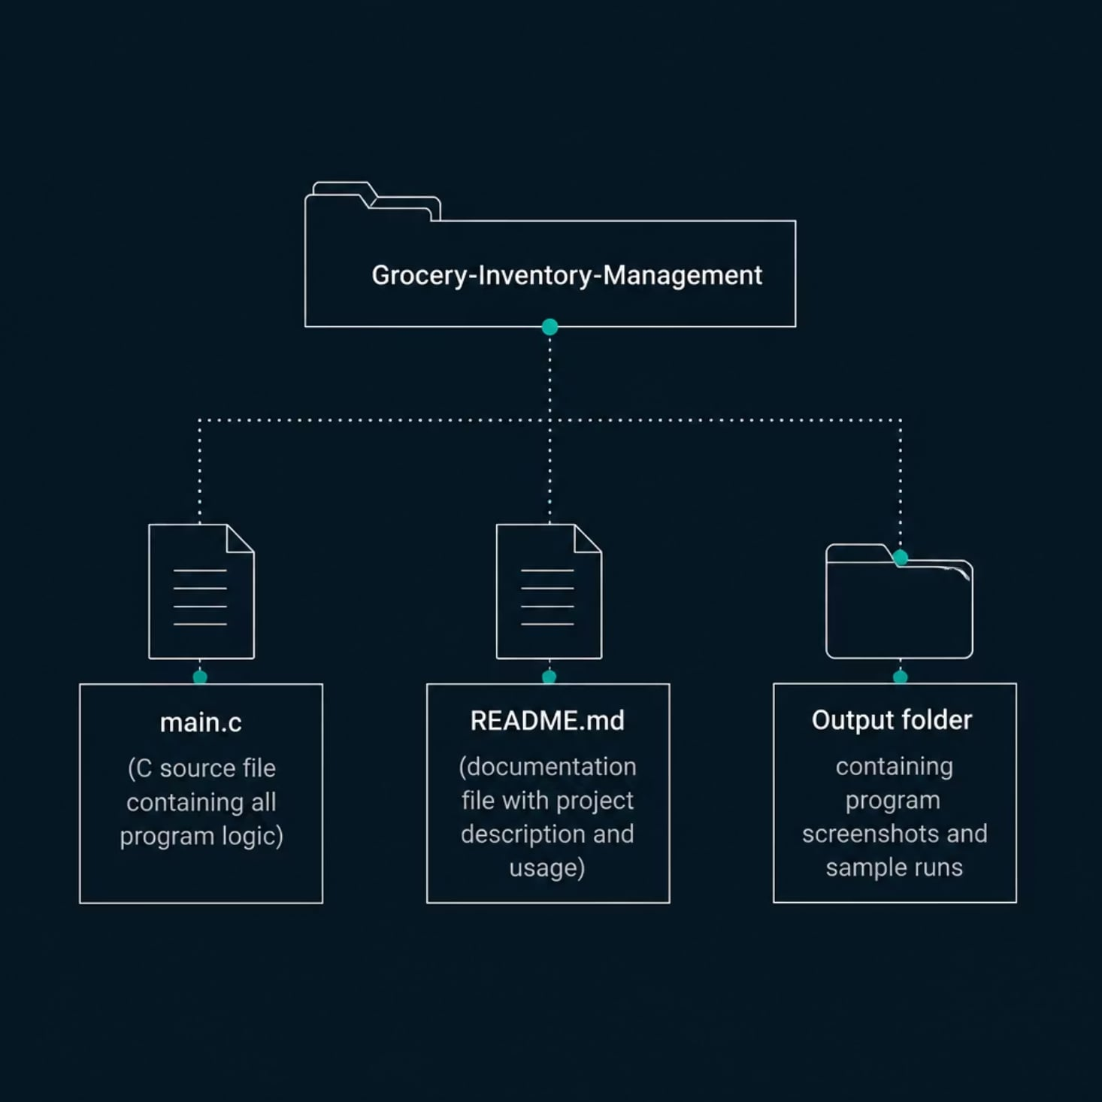
PROJECT STRUCTURE
Folder & File Organization
Repository Layout
A clean, minimal project structure keeps the codebase organized and easy to navigate for evaluation and future extension.
main.c — All source code and logic
README.md — Project documentation
Output/ — Screenshots & test runs

Slide 8

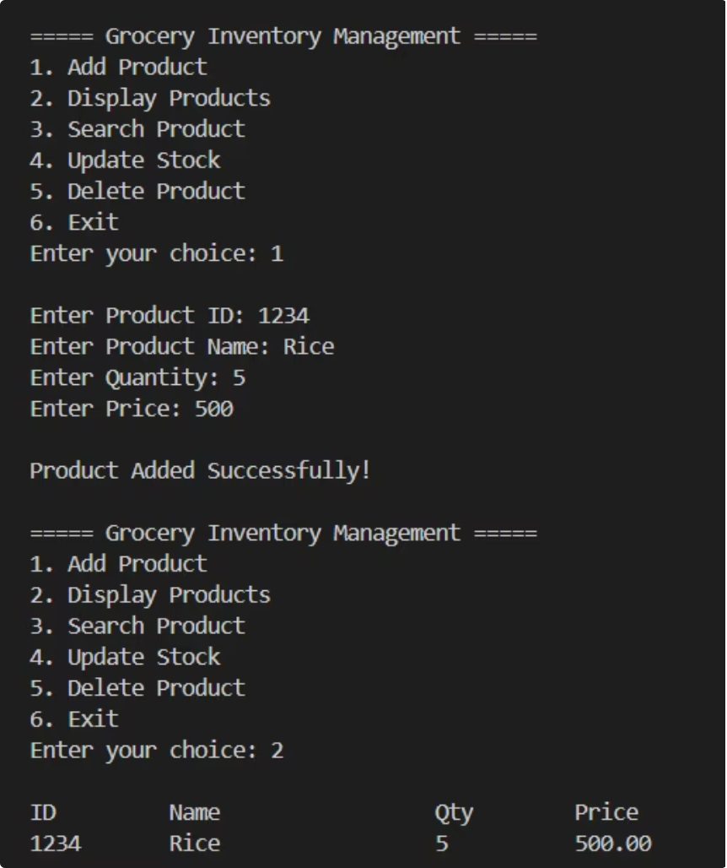
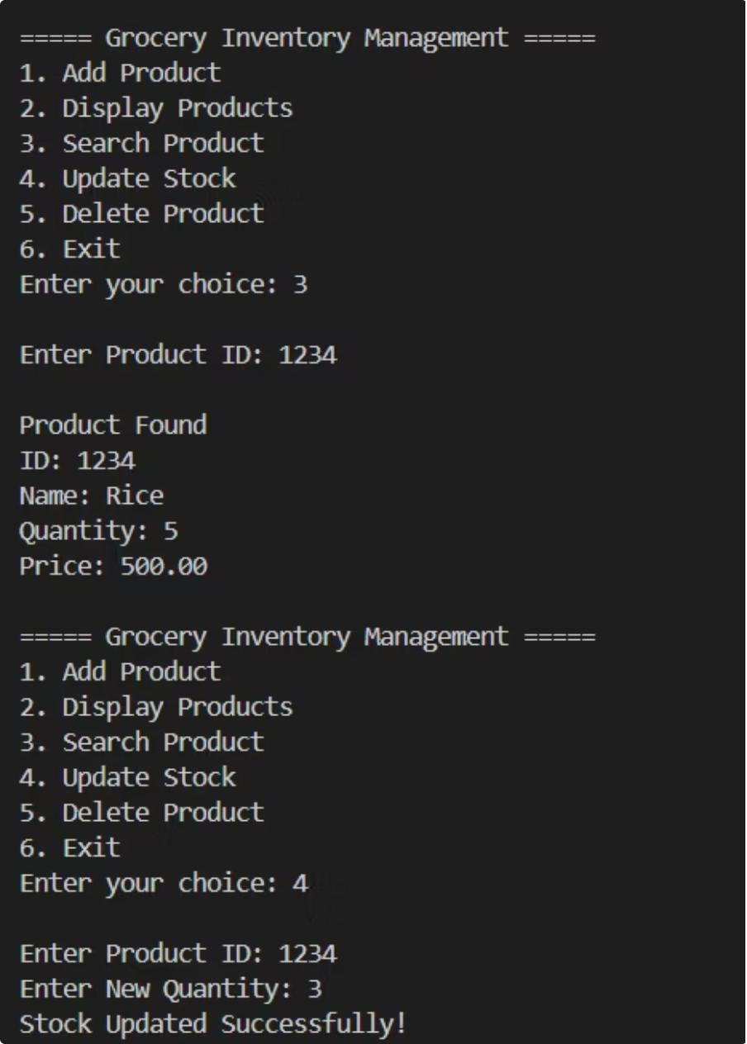
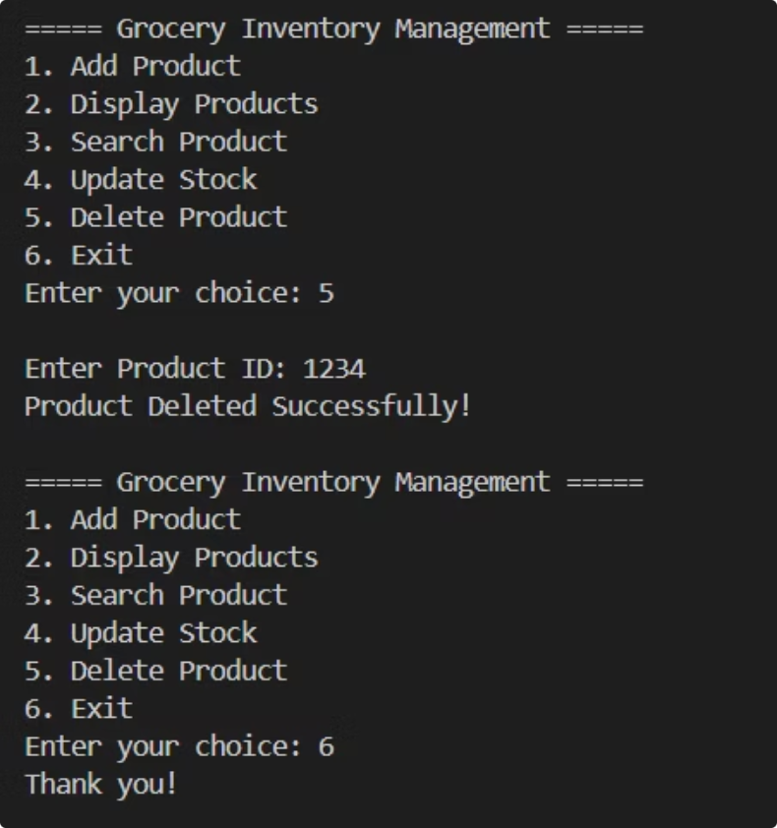
PROGRAM SCREENSHOTS
Console Output Gallery
Key screens from the running application.

Slide 9








Future Enhancements
File Handling
Billing System
Persist inventory data across sessions using file I/O
Generate itemized bills with totals and taxes
Barcode Scanner
Product Categories
Integrate hardware barcode input for faster product lookup
Organize items into sections like Dairy, Grains, Beverages
Low Stock Alerts
Expiry Date Management
Auto-notify when quantity falls below a threshold
Track and flag products nearing expiration
Database Integration
GUI Version
Migrate from arrays to SQLite for scalable storage
Build a graphical interface using GTK or ncurses

Slide 10

CONCLUSION
Thank You
"The Grocery Inventory Management System demonstrates the implementation of core C programming concepts — structures, arrays, functions, loops, and conditional statements — through a simple, functional console-based application."
✅ Problem Solved
Replaces error-prone manual registers with a digital system

